Slide 1
PBU Walls(TMP Grids)
TERRAHL2-FP_MB-T1am(JMB)

Slide 2
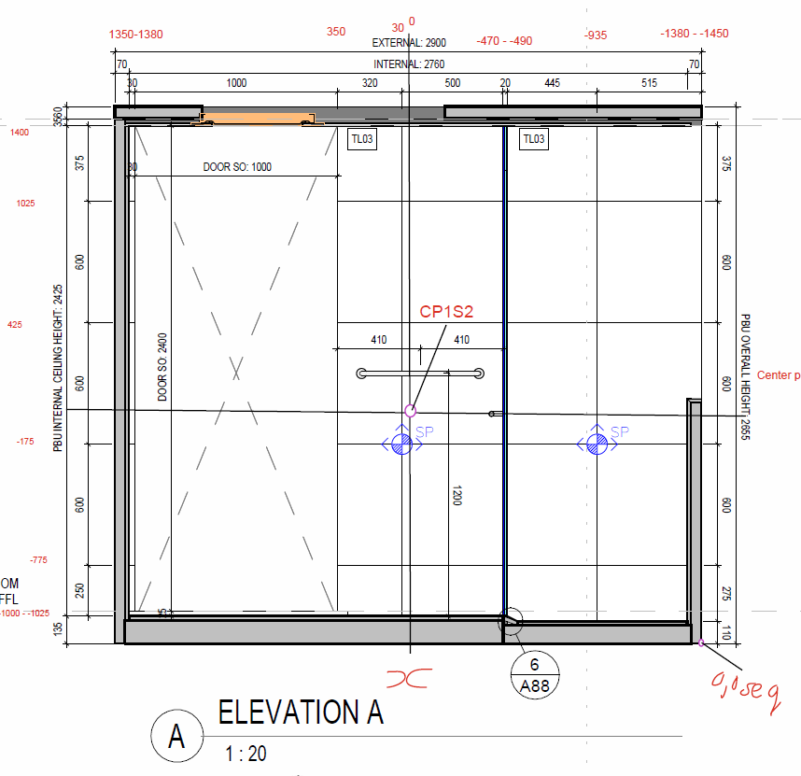
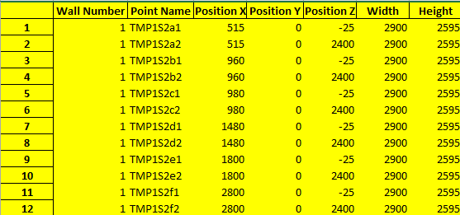
Wall 1
2800
1800
1480
960-980
515
2400
2025
1425
825
225

Slide 3
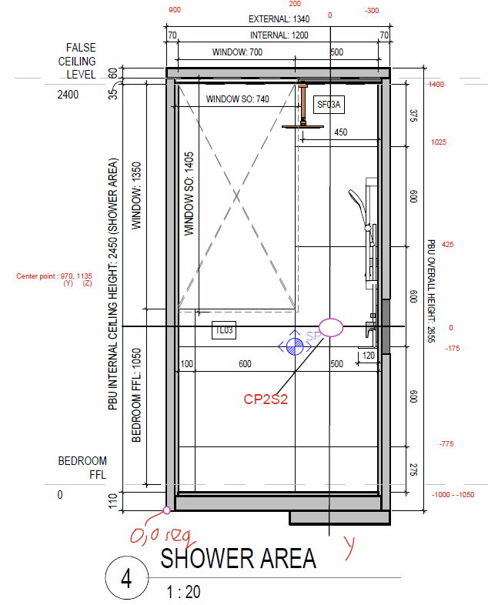

Wall 2
70
170
770
1270
2400
2025
1425
825
225

Slide 4
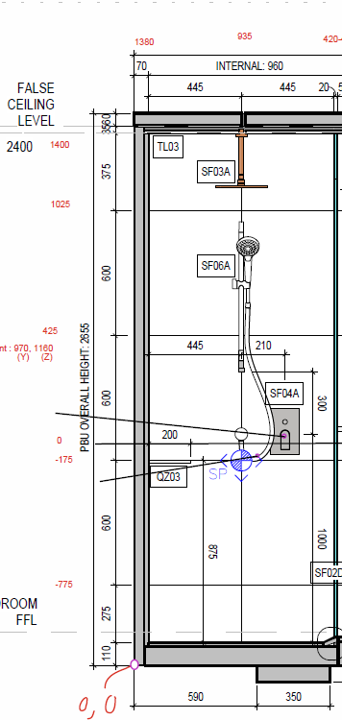
Wall 3
70
515
2400
2025
1425
825
225

Slide 5
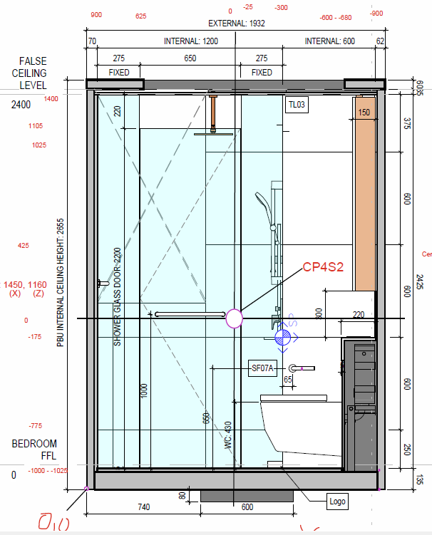
Wall 4
70
345
945
1270
1870
2400
2025
1425
825
225

Slide 6
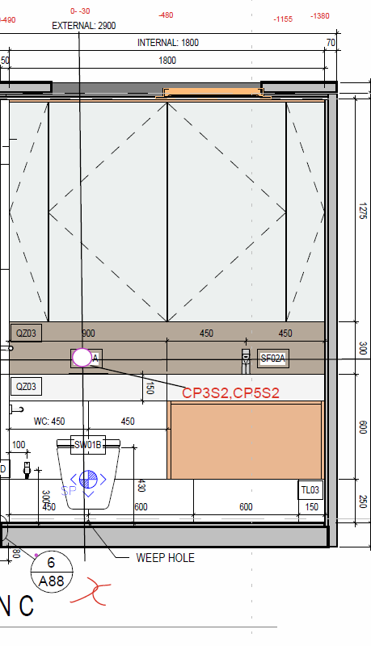

Wall 5
1030
1480
2080
2680
2400
1125
825
675
225

Slide 7
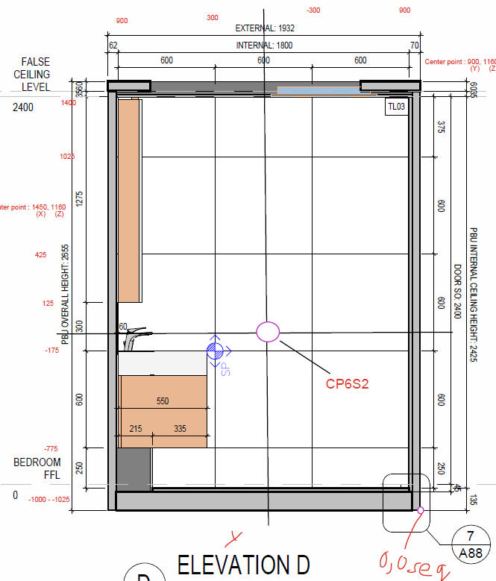

Wall 6
1870
1270
670
70
2400
2025
1425
825
225

Slide 8
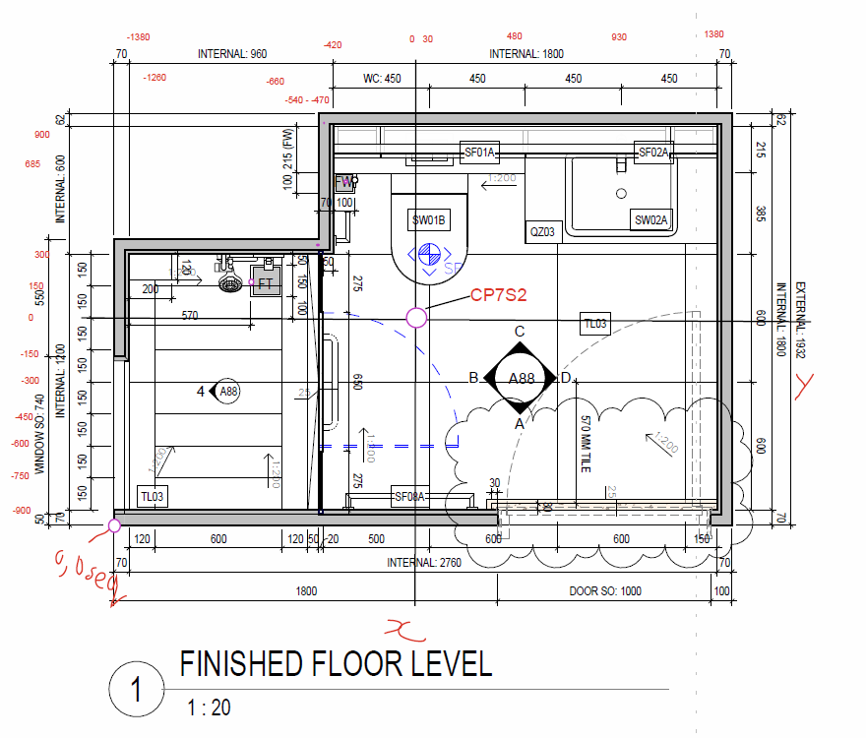
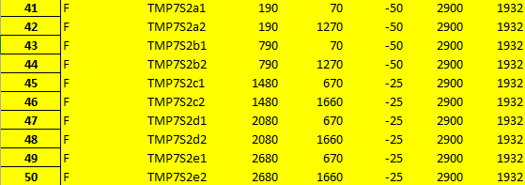
Floor
1270
670
2830 - 2900
70
190
790
910-980
1480
2080
2680

